Slide 1
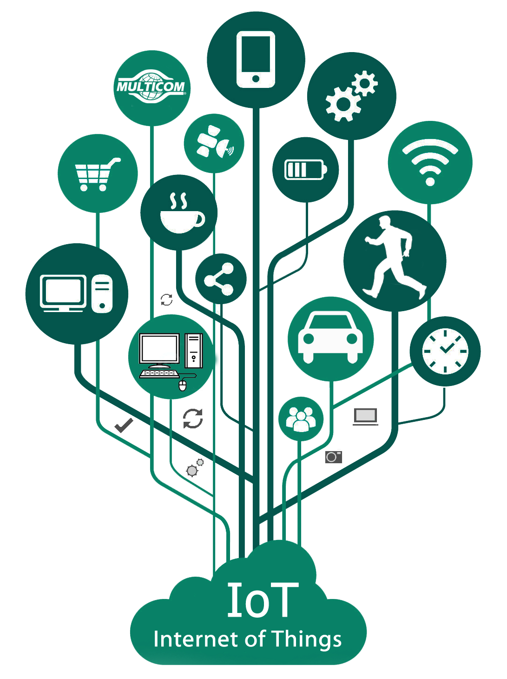
IoT Architecture
Dr. Upasana Dohare

Slide 2
Contents
IoT Open-source architecture (OIC):
OIC architecture & design principles, IoT devices and deployment models
IoTivity:
An open source IoT stack, Overview, IoTivity stack architecture, Resource model and Abstraction.
Middleware for IoT:
Overview, Communication middleware for IoT
SOA and Cloud computing
Cloud middleware, Cloud standards, Cloud providers and systems, Edge/fog computing

Slide 3
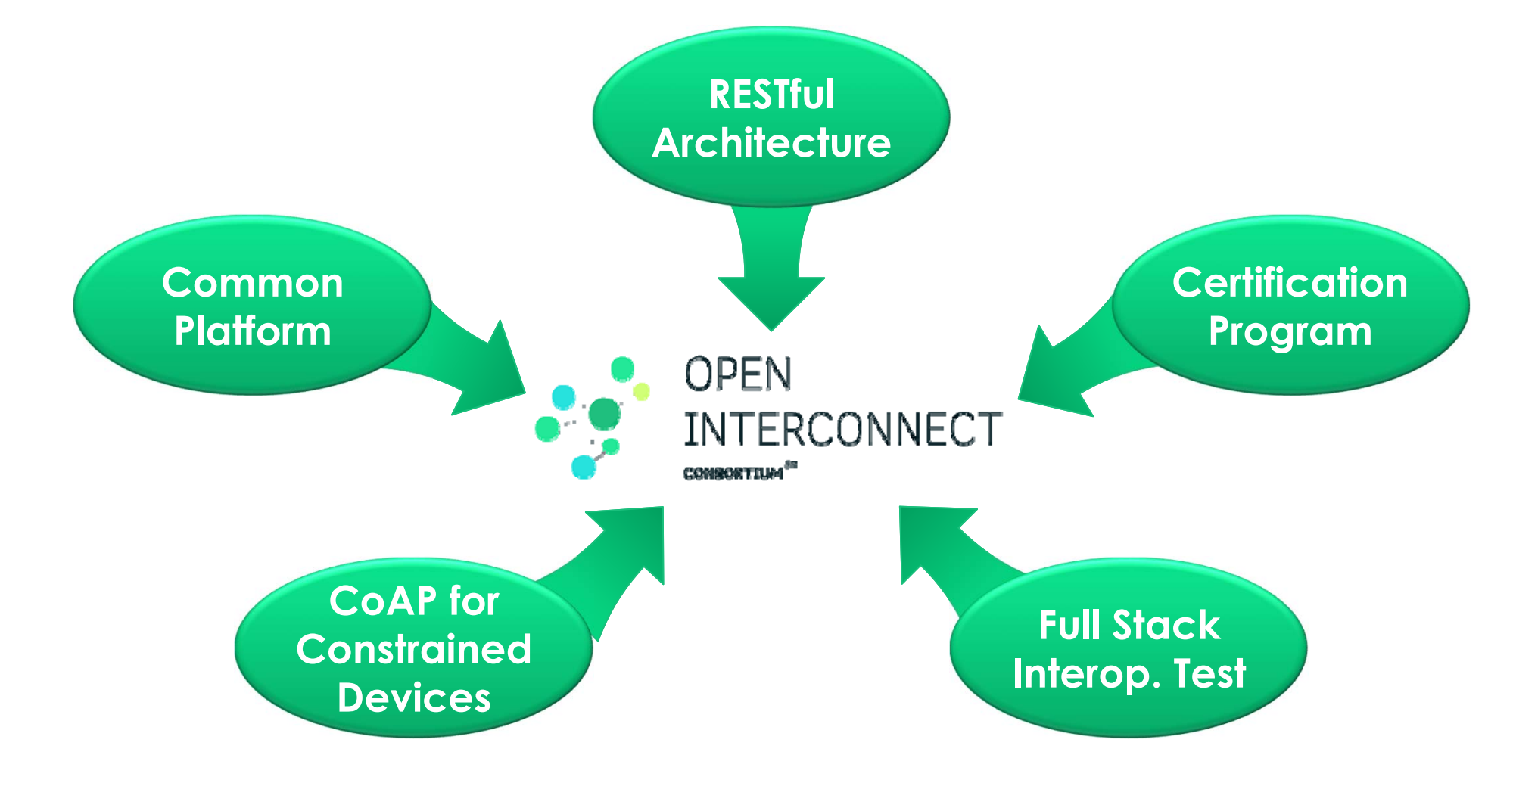
Open Interconnect Consortium (OIC)
The Open Interconnect Consortium (OIC) is a consortium founded by Intel, Dell, Samsung and Broadcom among others to promote standards for the development of the Internet of Things.
Its stated goal is "defining a common communications framework based on industry standard technologies to wirelessly connect and intelligently manage the flow of information among personal computing and emerging IoT devices, regardless of form factor, OS, or service provider."
In early 2015, the OIC released a specification called IoTivity, an open source framework implementing the OIC Standards for device-to-device connectivity.

Slide 4
IoT Open-source architecture (OIC):Key Concepts
The OIC tries to realize the Internet of Things also called Network of Everything. The IoT requires easy discovery, and trusted and reliable connectivity between things. The OIC delivers a framework that enables these requirements via a specification, a reference implementation and a certification program.
Current IoT connectivity difficulties…
Technical issues
Intellectual property rights issues
Organizational/structural issues
Platform independent
Scalable, flexible and can be deployed anywhere
Based on open standards
Streaming analytics and machine learning
Open and interoperable on the hybrid cloud
Application agility and integration

Slide 5
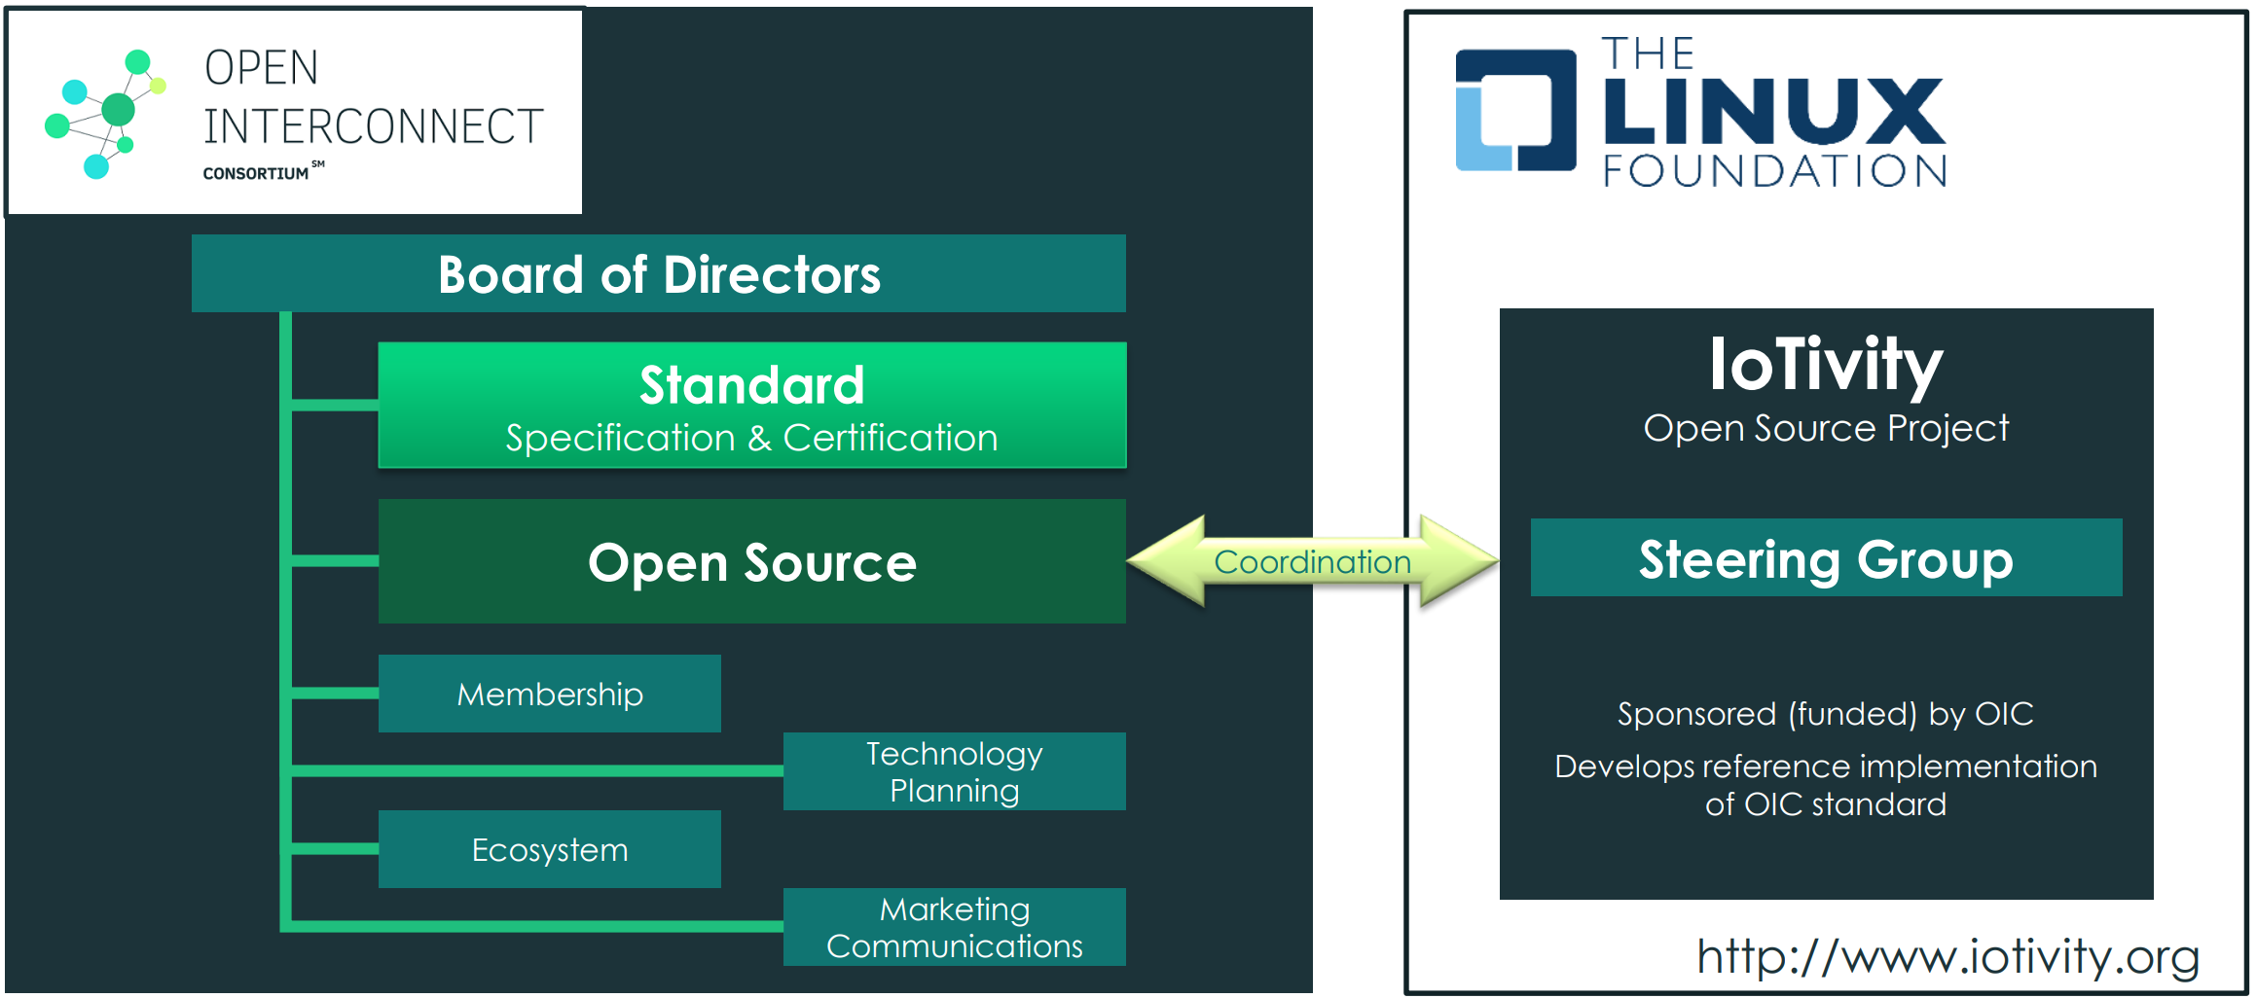
OIC Organizational Structure
It is an arrangement between Regulatory Authorities, it is very flexible, dynamic and proactive.
Open Interconnect Consortium (OIC) is being formed by…
– IoT industry leaders
– A connectivity framework
– Across vertical markets
– Standards development
– Open source
– Royalty free IPR
– An inclusive approach to technologies

Slide 6
OIC Design Principles
Core Framework Specification Scope
Specifies the technical specification(s) comprising of the corearchitectural framework, messaging, interfaces and protocols based on approved use-case scenarios
Enables the development of vertical profiles (e.g. SmartHome) on top of the core
Architect a core framework that is scalable from resource constrained devices to resource rich devices
Evaluate technical specification(s) for maximum testability and interoperability
Ensure alignment with OIC open source releases

Slide 7
OIC Roles
OIC Client –
i) Initiate an transaction (send a request) & ii) access an OIC Server to get a service
OIC Server –
i) host OIC Resource & ii) send a response & provide service

Slide 8
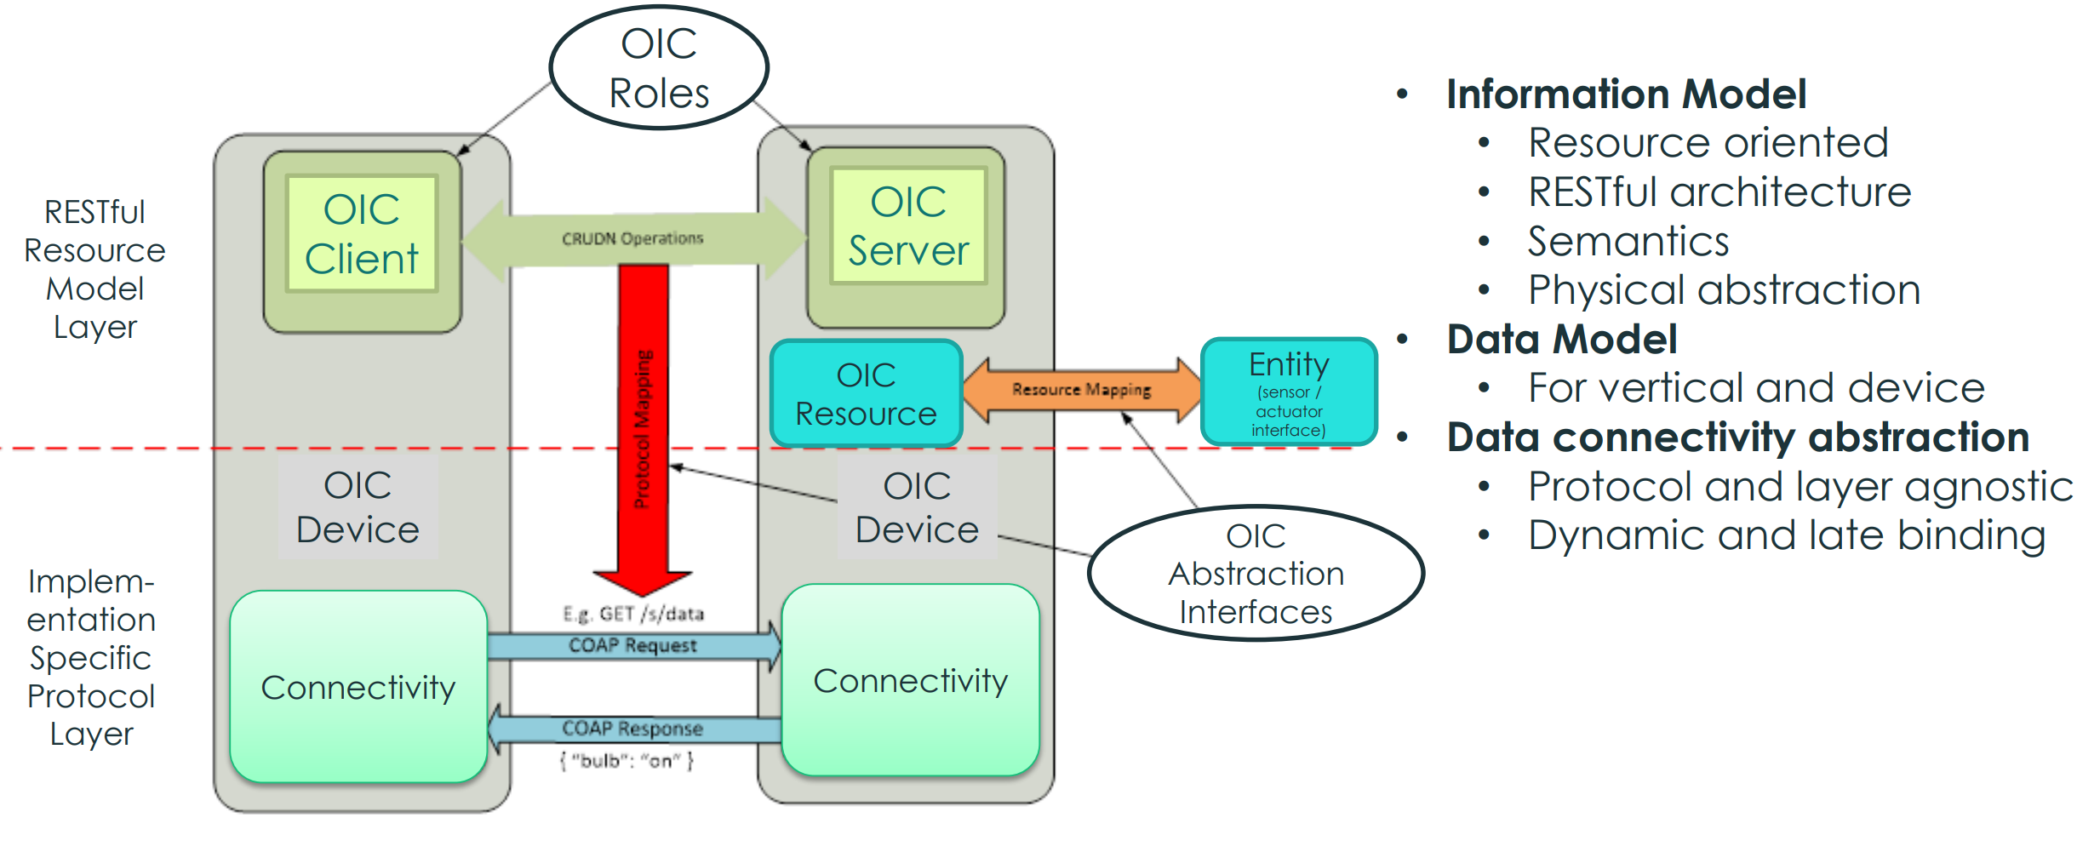
OIC Architecture
OIC adopted RESTful Architecture
Current OIC Architecture defines 2 logical roles that devices can take
OIC Server : A logical entity that exposes hosted resources
OIC Client : A logical entity that accesses resources on an OIC Server

Slide 9
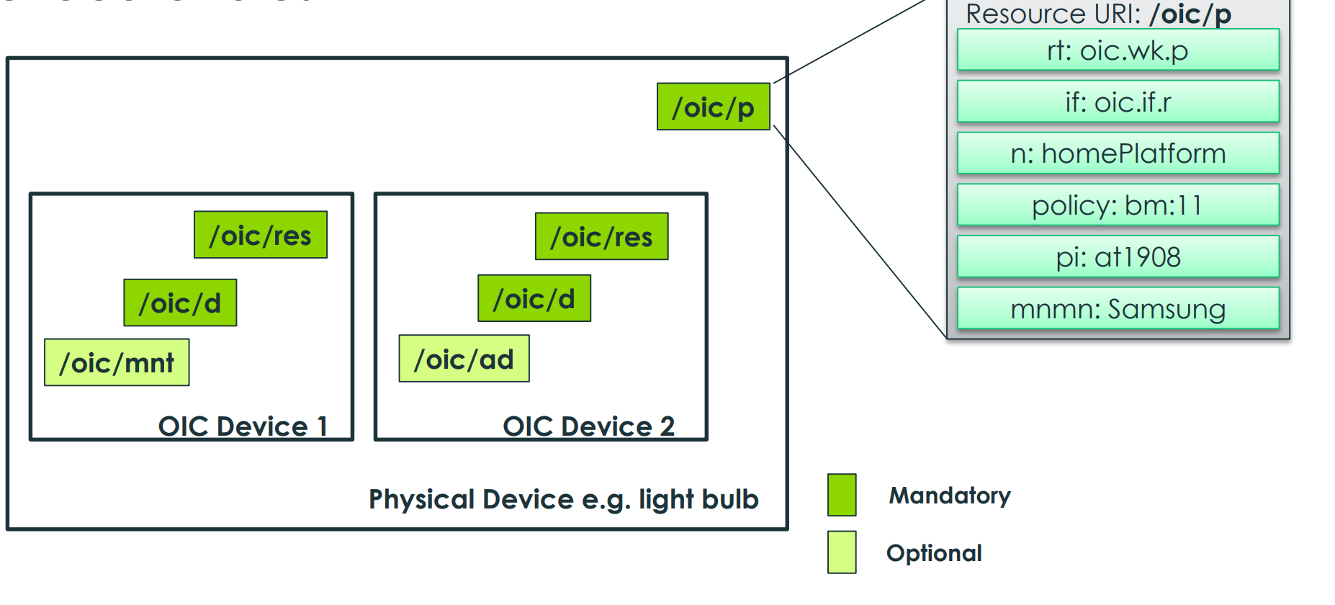
Organization of an OIC Device
OIC Device – abstraction on a platform to host resources and execute roles

Slide 10
IoT devices and deployment models
IoT deployment is expanding out from consumer-based applications such as smart home devices and wearables to applications in the areas of
public safety,
emergency response,
industrial automation,
autonomous vehicles, and
the Internet of Medical Things (IoMT).

Slide 11
A Three-Part Strategy for IoT Deployment
Several factors come into the successful deployment of an IoT system and its connected devices, including security, interoperability, power or processing capabilities, scalability, and availability.
A general strategy for implementation consists of three phases:
Consult: Having determined whether you will buy your IoT infrastructure or build it out yourself, it’s essential to first consult with the internal or external team responsible for running the project and establish a road map for your IoT deployment.
Develop: During the development phase, you should optimize the initial plans created during the consultation, for performance, cost, and quickest route to market.
Deploy: The deployment phase marks the culmination of all your plans and provisions for security and data privacy, testing and enablement of interoperability, and forward stocking for backup hardware, customer support, technical support for Wi-Fi or cellular networks, gateways, web interfaces, apps, and your cloud platform.

Slide 12
IoT Deployment At Large Scale
Devices: expect a mix of new and legacy devices employing different technologies and serving multiple purposes. This variation makes interoperability a key requirement.
Connectivity:All devices on the network need to support your preferred connectivity standard.
Device Management:Connectivity, industry standards, and protocols assume vital importance in device management for large-scale deployments.
Data Processing: all data should be aggregated and accessible via a centralized platform. This will also give system administrators a “big picture” view of the deployment.
A Flexible Management Platform: platform should be flexible enough to accommodate different solutions and able to adapt to future changes.

Slide 13
IoTivity : An Open source IoT stack, Overview
IoTivity is an open source software framework (OFC) enabling seamless device-to-device connectivity to address the emerging needs of the Internet of Things.
The OCF Secure IP Device Framework provides a versatile communications layer with best-in-class security for Device-to-Device (D2D) and Device-to-Cloud (D2C) connectivity over IP.
IoT interoperability is achieved through the use of consensus-derived, industry standard data models spanning an array of usage verticals.

Slide 14
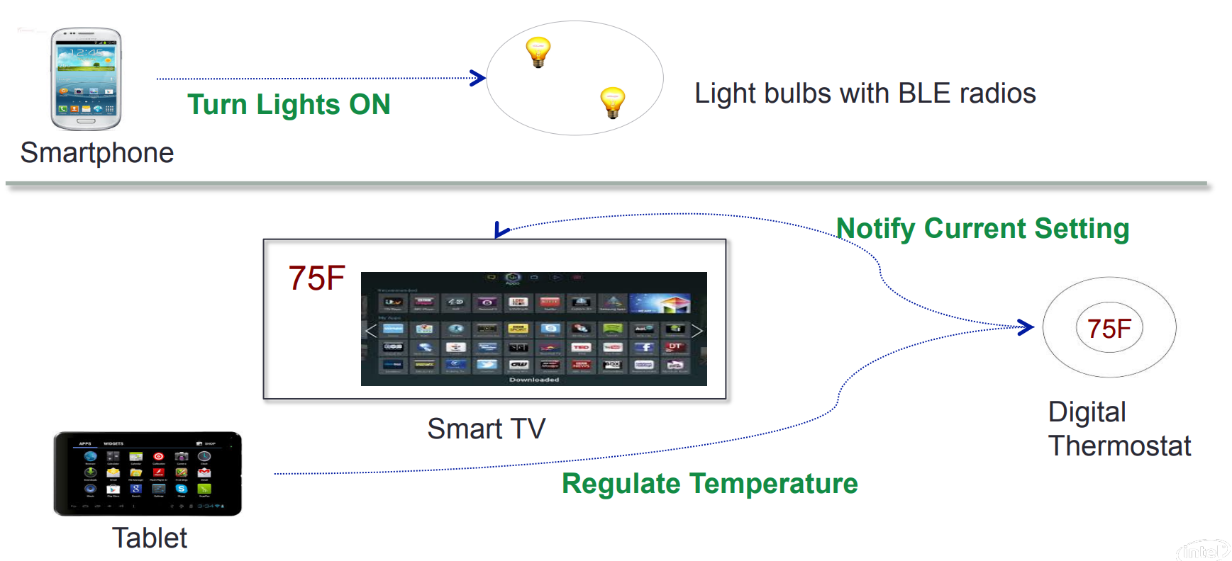
Why is IoTivity useful?
Cross-platform support
Uniform and easy-to-use APIs
Based on open standards
Support for multiple connectivity types
Extensible to support proprietary protocols

Slide 15
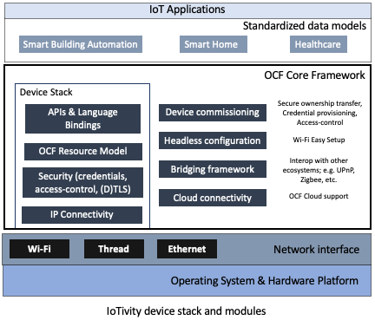
IoTivity stack architecture
The IoTivity device stack and modules work cross-platform (pure C code) and execute in an event-driven style.
The stack interacts with lower level OS/hardware platform-specific functionality through a set of abstract interfaces. This decoupling of the common OCF standards related functionality from platform adaptation code promotes ease of long-term maintenance and evolution of the stack through successive releases of the OCF specifications.

Slide 16
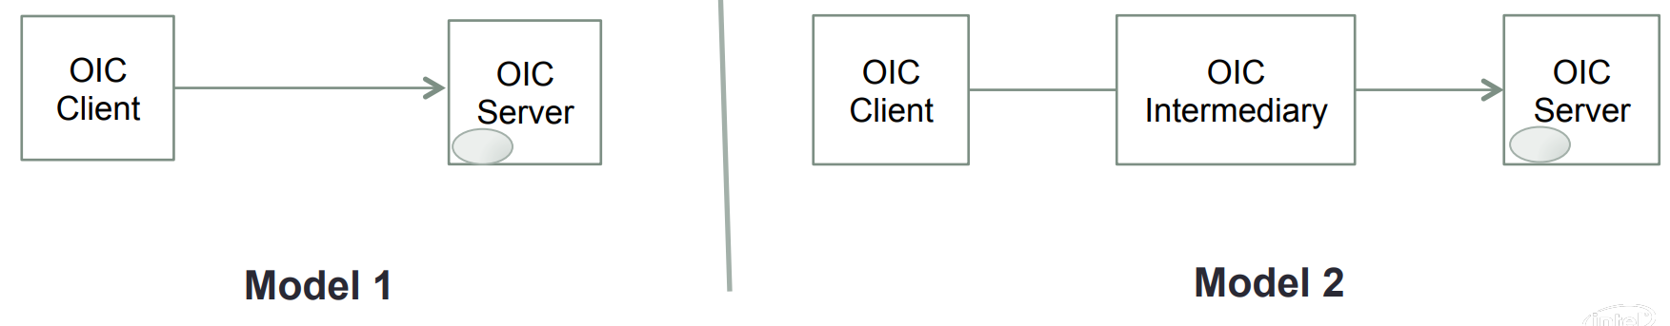
IoTivity resource model and abstraction
RESTful design -> Things modeled as resources
Server role: Exposes hosted resources
Client role: Accesses resources on a server
Intermediary role: Bridges messaging between client and server

Slide 17
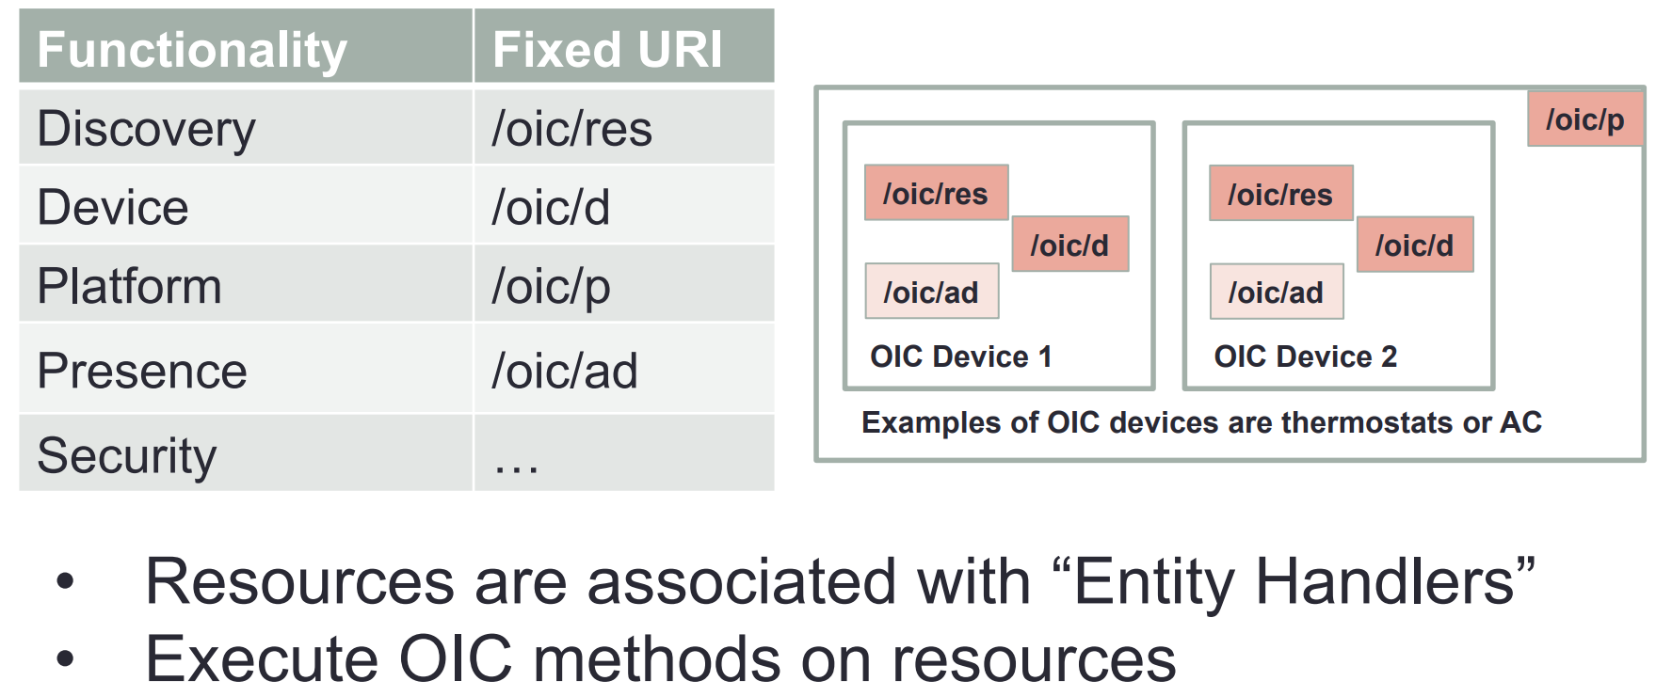
“Well-Known” resources

Slide 18
Middleware for IoT: Overview, Communication middleware for IoT
Internet of Things middleware is software that serves as an interface between components of the IoT, making communication possible among elements that would not otherwise be capable.
Middleware is part of the architecture enabling connectivity for huge numbers of diverse Things by providing a connectivity layer for sensors and also for the application layers that provide services that ensure effective communications among software.
Mulesoft, Oracle, RedHat and WSO2 are among the companies that offer IoT middleware

Slide 19
How IoT Middleware Works?
IoT middleware works by providing a layer of software between the hardware and applications layers in an IoT system.
The middleware layer provides a range of services and functionalities that enable the communication, coordination, and management of different IoT devices, platforms, and applications.

Slide 20
Components of IoT middleware
Communication middleware − This middleware layer is responsible for managing the communication between different IoT devices and platforms. It provides a set of protocols and standards for data exchange, and enables the translation of data between different formats and protocols.
Data management middleware − This middleware layer is responsible for managing the data generated by IoT devices. It provides a set of tools for collecting, storing, and processing data, and enables the integration of data from multiple sources.
Device management middleware − This middleware layer is responsible for managing the configuration, monitoring, and control of IoT devices. It provides a set of tools for device registration, provisioning, and firmware updates, and enables remote management of IoT devices.
Security middleware − This middleware layer is responsible for providing security and privacy services to IoT applications. It provides a set of tools for authentication, authorization, and encryption, and enables secure communication between IoT devices and applications.

Slide 21
Types of IoT Middleware and Their Functionalities
Application enablement platforms (AEPs) − AEPs provide a set of tools and services for building, deploying, and managing IoT applications.
Integration middleware − Integration middleware provides a set of tools for integrating different IoT devices and platforms.
Gateway middleware − Gateway middleware provides a layer of software between IoT devices and the cloud, enabling local processing and analysis of IoT data.
Message-oriented middleware (MOM) − MOM provides a set of tools for managing message-based communication between different IoT devices and platforms.

Slide 22
What is Service Oriented Architecture (SOA)?
SOA defines a way to make software components reusable using the interfaces.
Formally, SOA is an architectural approach in which applications make use of services available in the network.
In this architecture, services are provided to form applications, through a network call over the internet.

Slide 23
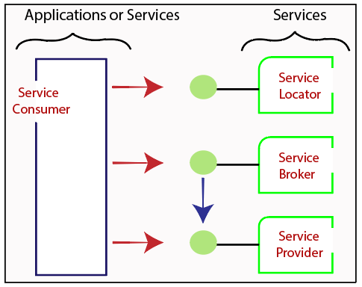
Service-Oriented Terminologies
Services - A service is a well-defined, self-contained function that represents a unit of functionality.
Service provider - It is a software entity that implements a service specification.
Service consumer - It can be called as a requestor or client that calls a service provider. A service consumer can be another service or an end-user application.
Service locator - It is a service provider that acts as a registry. It is responsible for examining service provider interfaces and service locations.
Service broker - It is a service provider that pass service requests to one or more additional service providers.

Slide 24
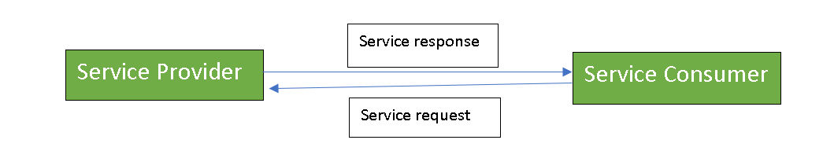
What is Service Connections?
The service connection is understandable to both the service consumer and service provider.
Services might aggregate information and data retrieved from other services or create workflows of services to satisfy the request of a given service consumer. This practice is known as service orchestration
Another important interaction pattern is service choreography, which is the coordinated interaction of services without a single point of control.

Slide 25
Characteristics of SOA
The services have the following characteristics:
They are loosely coupled.
They support interoperability.
They are location-transparent
They are self-contained.

Slide 26
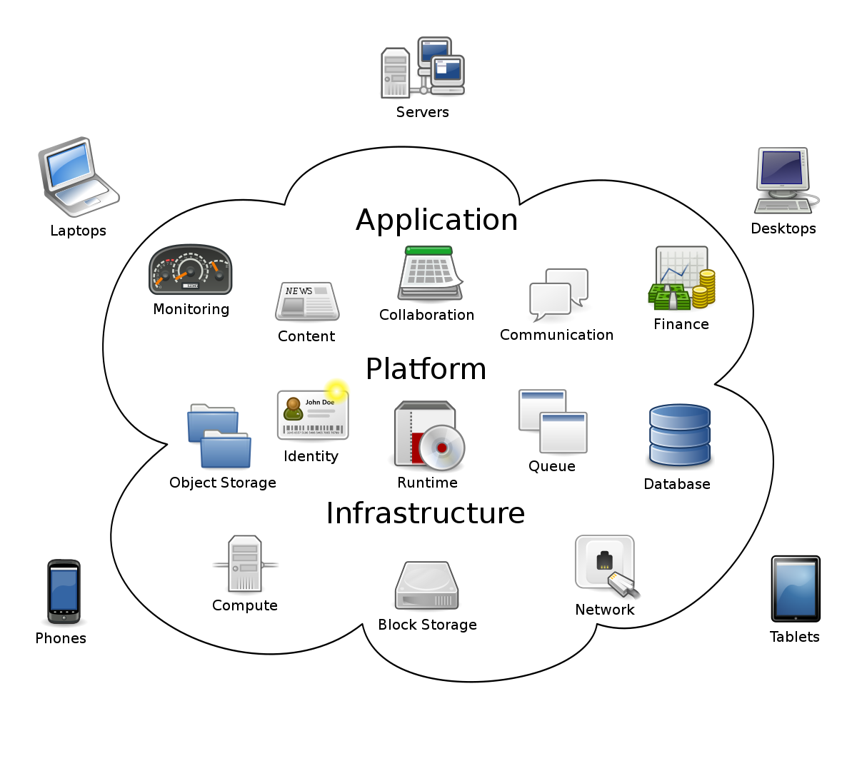
Cloud Computing
The key to cloud computing is the “cloud”—a huge network of servers or even individual PCs interconnected in a grid (network).
These computers run in parallel, combining the resources of each to generate supercomputing-like power.
What, exactly, is the “cloud”?
The cloud is a collection of computers and servers that are openly accessible via the Internet.
Cloud is an acronym of the phrase: Common, Location independent, Online Utility that is available on Demand.

Slide 27
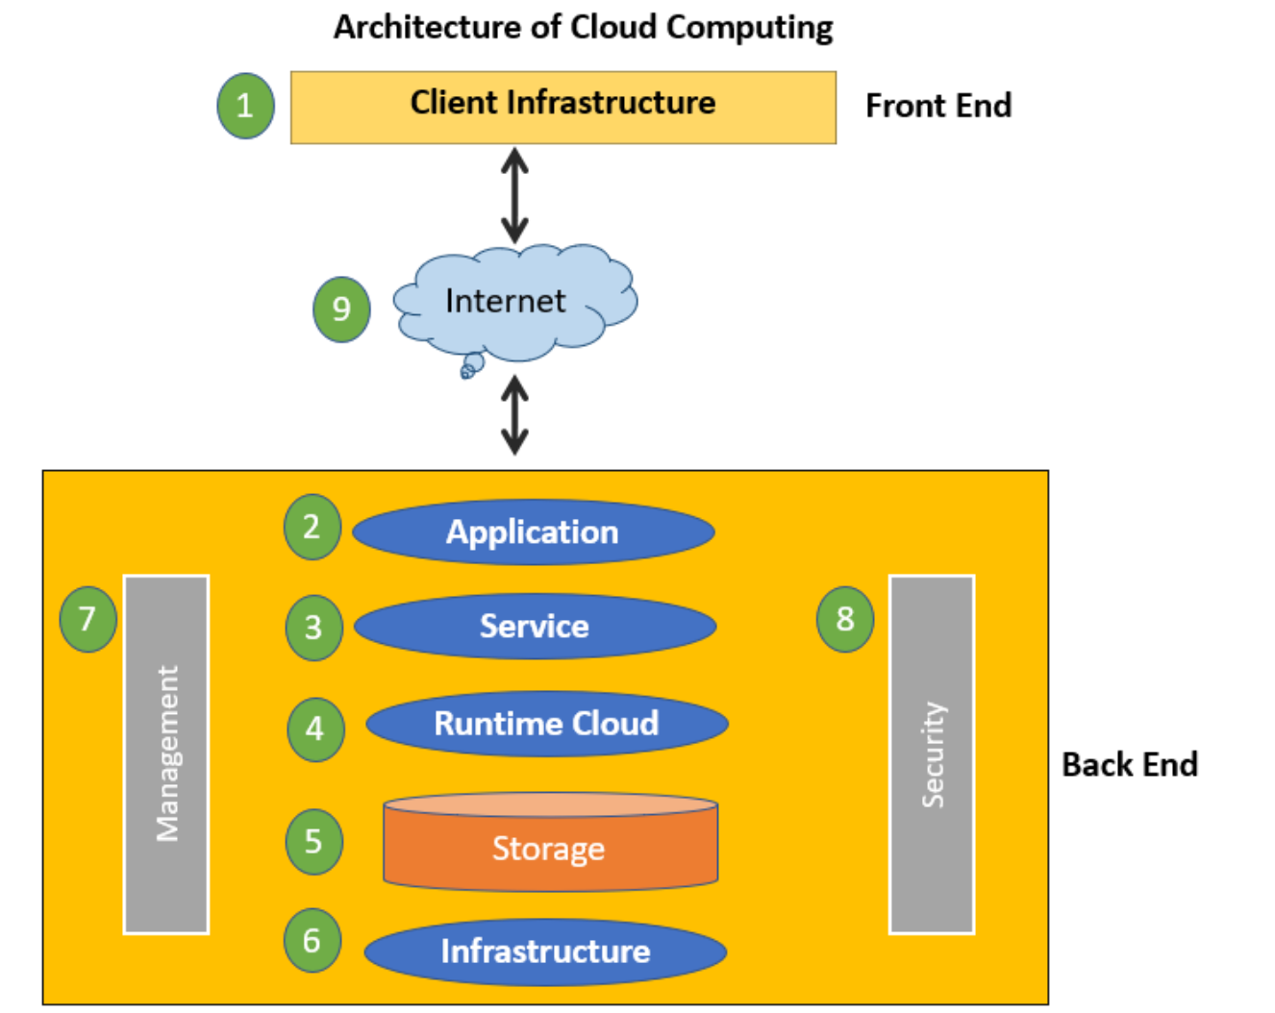
Cloud Computing Architecture
The cloud architecture is mainly divided into 2 parts i.e.
Front End:
The client uses the front end, which contains a client-side interface and application.
Both of these components are important to access the Cloud computing platform. The front end includes web servers (Chrome, Firefox, Opera, etc.), clients, and mobile devices.
Back End:
The backend part helps you manage all the resources needed to provide Cloud computing services.
This Cloud architecture part includes a security mechanism, a large amount of data storage, servers, virtual machines, traffic control mechanisms, etc.

Slide 28
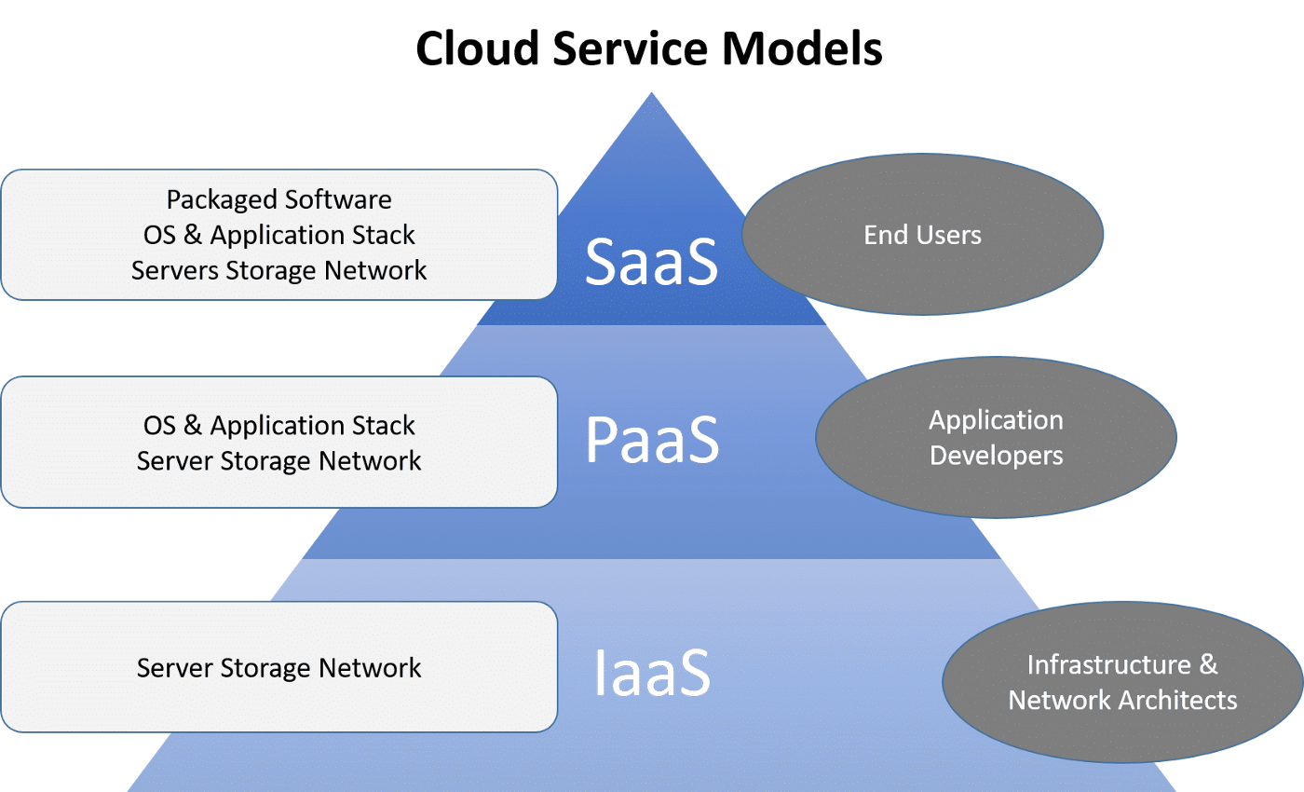
Types of Basic Cloud Computing Services
There are also 3 main types of cloud computing services:
Software-as-a-Service (SaaS)
Platforms-as-a-Service (PaaS)
Infrastructure-as-a-Service (IaaS)

Slide 29
The Role of Cloud Computing on the Internet of Things:
The role of cloud computing in IoT is to work together to store IoT data, providing easy access when needed.
It’s important to note that cloud computing is an easy way to move large data packets across the Internet generated by the IoT.

Slide 30
Cloud Middleware
Middleware is software and cloud services that provide common services and capabilities to applications and help developers and operators build and deploy applications more efficiently.
Middleware acts like the connective tissue between applications, data, and users.
There are many types of middleware. Some, such as message brokers or transaction processing monitors, focus on one type of communication.
Others, such as web application servers or mobile device middleware, provide the full range of communication and connectivity capabilities needed to build a particular type of application.

Slide 31
Cloud middleware and its advantages
Cloud middleware adapts flexibly to the requirements of the company and is thus enormously flexible and versatile.
Middleware as a Service
The provision of middleware as a service means a prefabricated package of cloud-based automation services to be used for complex, compound automations. This results in a MWaaS suite.
This includes various cloud services, API integrations, API management, B2B integration and the integration of data sources. Thus, iPaaS, apiPaaS, mobile backend as a service (MBaaS) and other cloud-based integration services are combined in a MWaaS suite.
The goal is to automate and support digital business processes, customer journeys and employee journeys in the best possible way.

Slide 32
Cloud Standards
Cloud Standards is a broad discussion of important existing and future standards. For existing standards, the discussion focuses on how they are used, providing practical advice to engineers constructing clouds and services to be deployed on clouds.
Some Cloud Security Standards are:
Object Management Group (OMG): An international, open membership, not-for-profit computer industry standards consortium. OMG Task Forces develop enterprise integration standards for a wide range of technologies.
Cloud Security Alliance: Is a member driven organization with a mission to use best practices for providing security assurance within Cloud Computing, and provide education on the uses of Cloud Computing.
Cloud Standards Customer Council: Is an end user advocacy group dedicated to accelerating cloud’s successful adoption, and drilling down into the standards, security and interoperability issues.
Open Data Center Alliance: Is an independent organization that gives stakeholders a voice in shaping the future of cloud computing
Open Compute Foundation: An open-source data center and hardware design community.
Open Cloud Consortium: A non-profit venture which provides cloud computing resources to support scientific community.
Storage Networking Industry Association: A non-profit association of producers and consumers of storage networking products.

Slide 33
What role governments need to play and what actions different governments are taking to shape the cloud standards?
European Union (EU) is working on the policy framework with an objective to adopt cloud service. Some of the policy framework actions are to
Common data protection and privacy protection regulation across the EU
Data jurisdiction regulation providing guidelines across EU.
Promoting common standards and interoperability of cloud systems.
Establishing policy for accountability and liability for security breaches
Certifications for cloud service vendors on their security and data protection management.

Slide 34
Cloud Providers and Systems
A CSP (cloud service provider) is a third-party company that provides scalable computing resources that businesses can access on demand over a network, including cloud-based compute, storage, platform, and application services.
Amazon Web Services (AWS), Microsoft Azure, and Google Cloud Platform (GCP) are the cloud service providers with the largest market share, collectively capturing over 65% of spending on cloud infrastructure services.

Slide 35
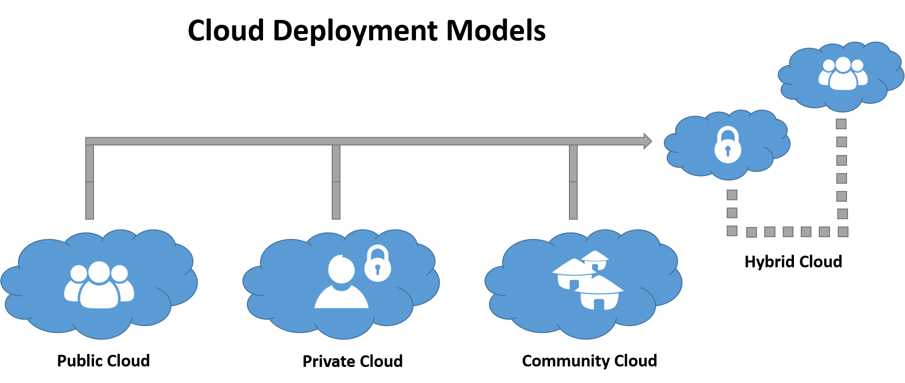
Cloud Computing Systems?
There are the following 4 types of cloud that you can deploy according to the organization's needs-
Public cloud: This cloud infrastructure is available to public or large industries.
Private cloud: These are functions within the organization.
Community cloud: This cloud infrastructure is common to several organizations.
Hybrid cloud: It is a composite of two and more clouds.

Slide 36
Edge/Fog computing
Edge Computing
Computation takes place at the edge of a device’s network, which is known as edge computing.
That means a computer is connected with the network of the device, which processes the data and sends the data to the cloud in real-time.
That computer is known as “edge computer” or “edge node”.

Slide 37
Edge/Fog computing
Example of Edge computing:
Autonomous vehicle edge computing devices collect data from cameras and sensors on the vehicle, process it, and make decisions in milliseconds, such as self-parking cars.
In order to accurately assess a patient’s condition and foresee treatments, data is processed from a variety of edge devices connected to sensors and monitors.

Slide 38
Edge/Fog computing
Fog Computing
Fog computing is an extension of cloud computing.
It is a layer in between the edge and the cloud.
When edge computers send huge amounts of data to the cloud, fog nodes receive the data and analyze what’s important. Then the fog nodes transfer the important data to the cloud to be stored and delete the unimportant data or keep them with themselves for further analysis.
In this way, fog computing saves a lot of space in the cloud and transfers important data quickly.

Slide 39
Difference Between Edge Computing and Fog Computing
S.NO. | EDGE COMPUTING | FOG COMPUTING
01. | Less scalable than fog computing. | Highly scalable when compared to edge computing.
02. | Billions of nodes are present. | Millions of nodes are present.
03. | Nodes are installed far away from the cloud. | Nodes in this computing are installed closer to the cloud(remote database where data is stored).
04. | Edge computing is a subdivision of fog computing. | Fog computing is a subdivision of cloud computing.
05. | The bandwidth requirement is very low. Because data comes from the edge nodes themselves. | The bandwidth requirement is high. Data originating from edge nodes is transferred to the cloud.
06. | Operational cost is higher. | Operational cost is comparatively lower.

